Slide 1
RESPONSIBLE CONSUMPTION AND PRODUCTION
GROUP E
GROUP MEMBERS:
MUHAMMAD ASYRAF HAFIDZI BIN ABDUL LATIFF
MUHAMMAD NIAMAT BIN ZAINON
MUHAMMAD AMIR DZAKWAN BIN ALIAS
ADAM BIN MOHD SALIM
ANSHARI BIN AMRAN

Slide 2
Introduction
In Perlis, there is no innovative and systematic system to be a medium to sell and buy used items such as antique. As the phrase, another man trash is another man treasure. Monitoring used items is very important to optimize garbage resources, and cost and reduces manpower to handle the garbage collection. his can be done using e-commerce trading. Ecommerce or electronic commerce is the trading of goods and services on the internet.

Slide 3
Problem Statement
Malaysians throw away 36,699 tons of garbage every day. This means that every Malaysian throws away 1.17kg of solid waste on an average. Domestic waste is any solid waste produced from household and commercial activities. Current garbage collection is required a huge amount of human energy. Thus, It will create an unhygienic condition for surrounding environment.

Slide 4
Objectives
The main objectives of the project are:
1. To study the use of programming in helping to reduce garbage.
2. To design a medium or market place for used items.
3. To develop a medium or market place for used item.

Slide 5
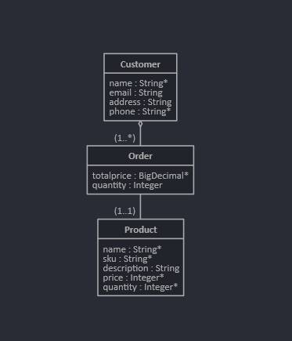
Project Design

Slide 6
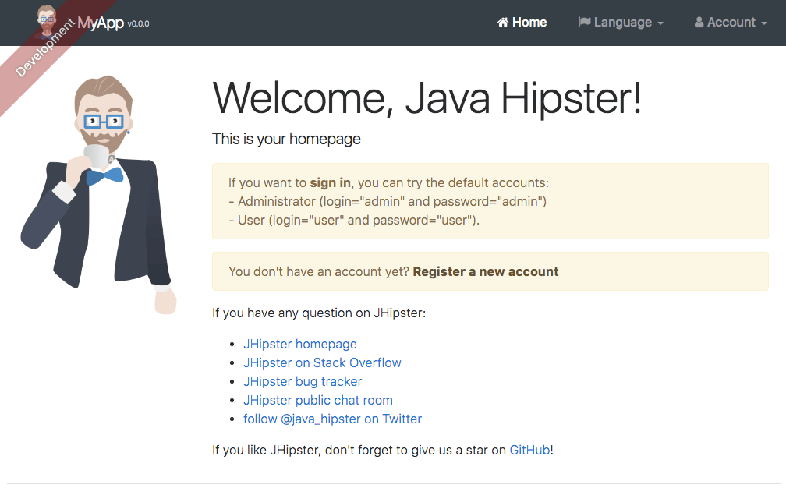


Development Software
This project was developed using several main development software.
Such are: Angular, JHipster, Visual Studio Code, Java DevKit.

Slide 7
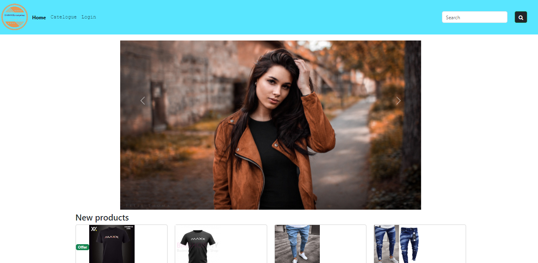
Result

Slide 8
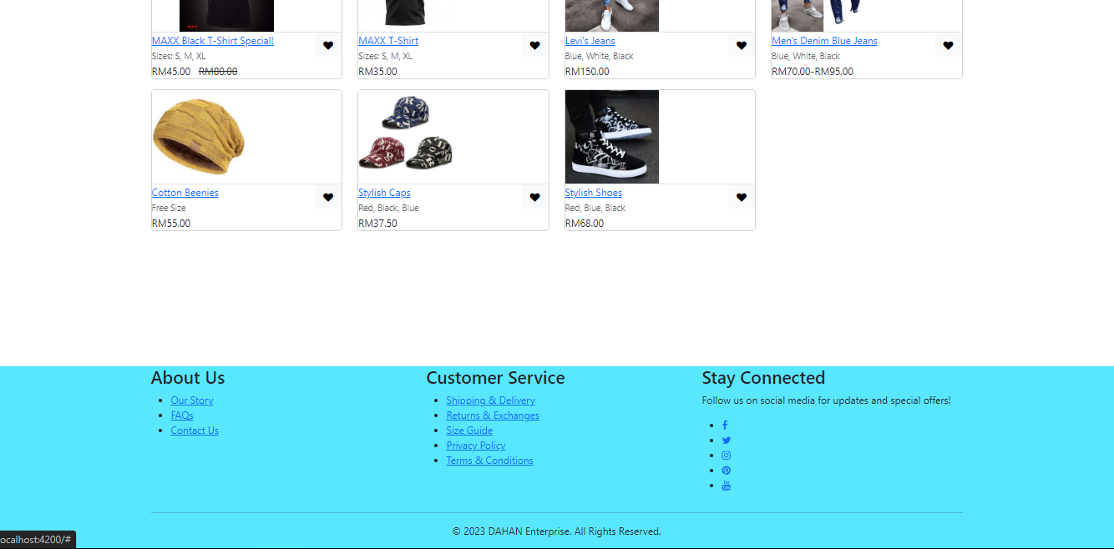

Slide 9
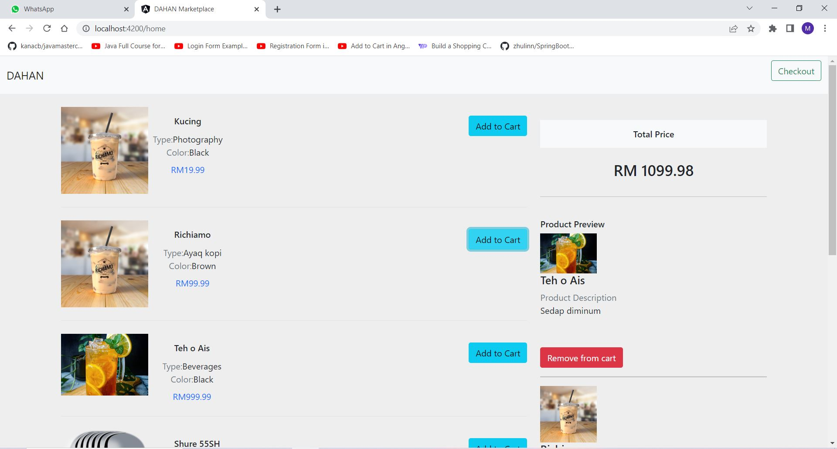

Slide 10
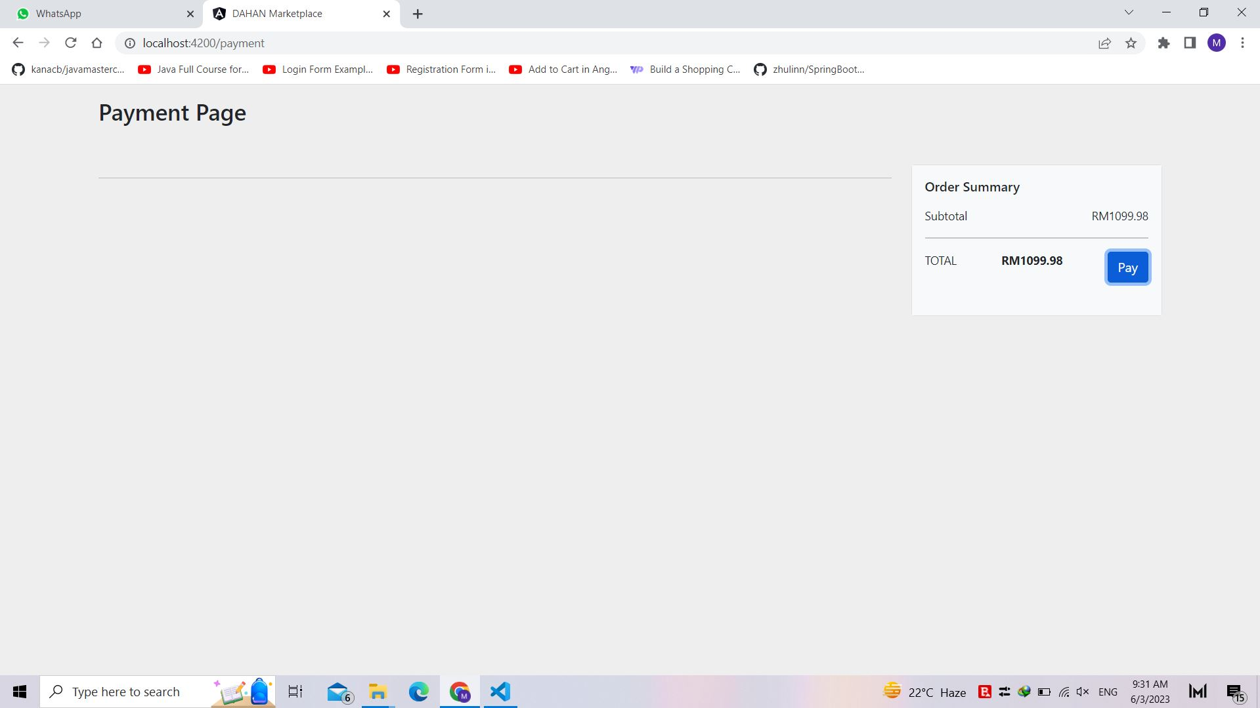

Slide 11
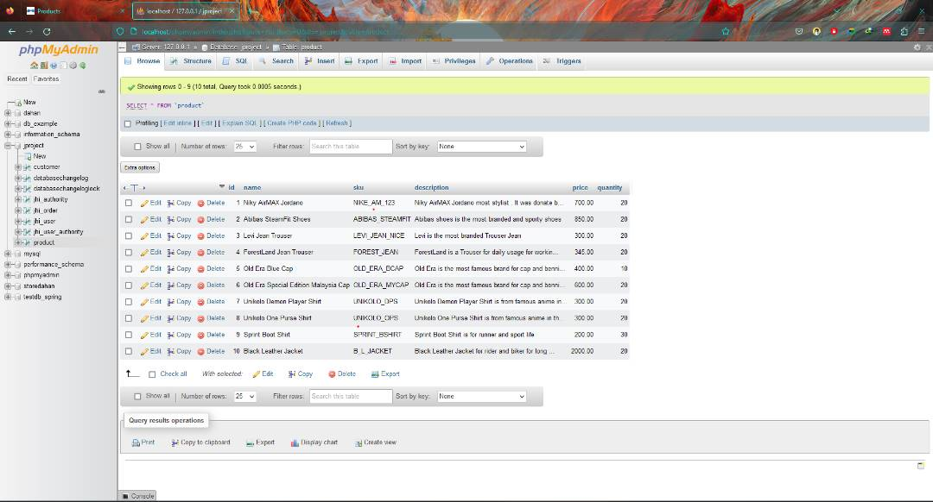

Slide 12
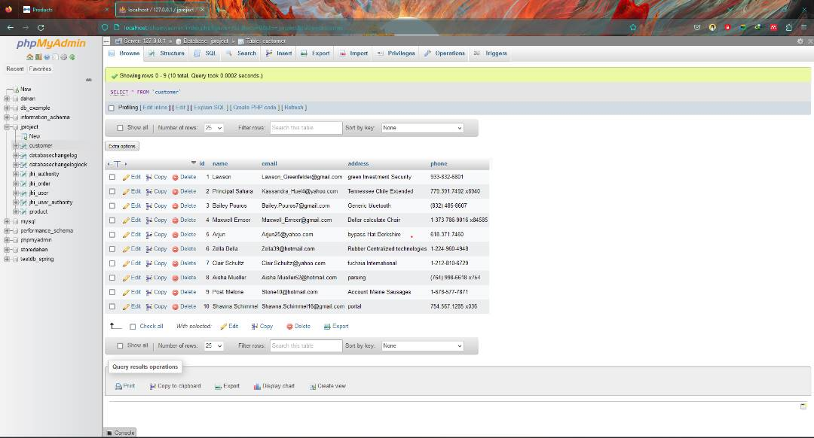

Slide 13
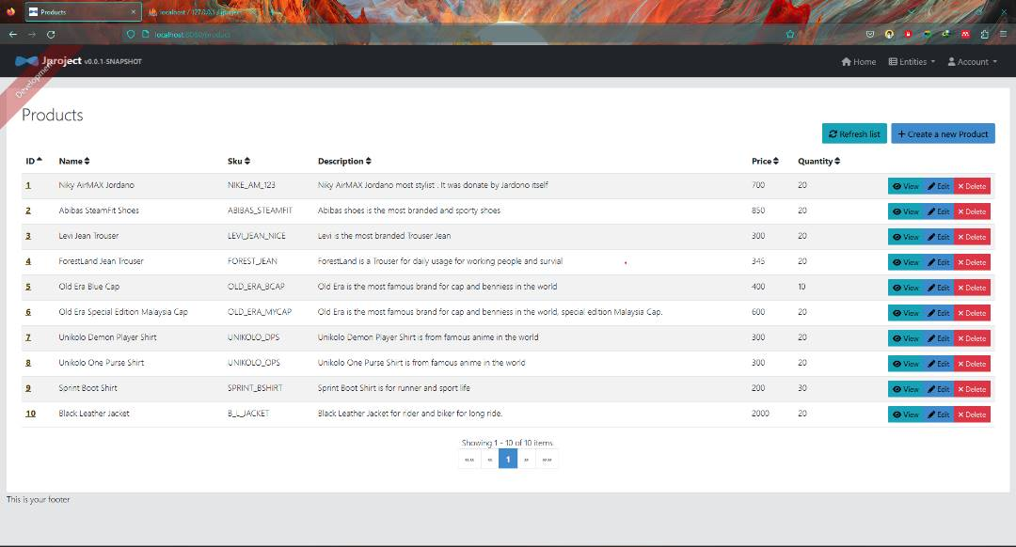

Slide 14
